Slide 1
ONLINE UNUSED MEDICINE DONATION SYSTEM FOR NGOs
Presented by:
NAME :SERU NAGA SATYA SAI DURGA
Reg No :21P31F0066
Aditya college of Engineering and Technology
Internal Guide: Mrs.N.VANI

Slide 2
• Abstract
• Existing system and Disadvantages
• Proposed system and Advantages
• System Architecture
• Functional Requirements
• System Requirements
• Modules
• UML Diagrams
• Screen shots
Conclusion
CONTENTS

Slide 3
ABSTRACT
Many human beings in India live in excessive poverty. So, it will become hard for those human beings with low income to pay for his or her health care and medication. As a give up end result, they stay with several diseases and as a end result, the wide sort of deaths will increase every day.
Apart from that, There are numerous people who are overdosing on tablets even after they have stopped their medication. right here, we've got set up a web page for donating medicines to NGOs.
This software will assist humans in donating their unused medicines treatments to NGOs and they may be able to distribute them to people who need them. This website will help in reducing the fee of fitness services through making better use of unused pills as well as assisting bad or human beings with low profits to get higher healthcare.
This website on-line is likewise assisted in assessing the supply of crucial drugs for nearby NGOs. The cause of this project is to donate unused drug treatments. Unused remedy can be donated to the horrific for in addition use.

Slide 4
This software enables clients donate unused drugs to NGOs. Administrators manage individuals by means of logging in and deleting and blockading customers who have supplied wrong or expired drugs.
The administrators manage people through logging in and deleting or blocking clients who've supplied incorrect or expired medicines. The administrator wants to affirm the expiration date of the drugs. NGOs help control inventory and music available medications.

Slide 5
EXISTING SYSTEM
In the existing system, if someone have to donate medicines through an NGO one has to visit an NGO physically taking the medicines along with them and donating them.
This is a very tiring and time-consuming process which might make it impossible for the donors to donate medicines.
If a donor donates the medicines to a NGO the NGO might or might not find them useful and they might get expired.
The NGOs might not have proper storage facility to store all the donated medicine.

Slide 6
Limitations:
Currently there is only physical donation of everything. The existing system can only limit the level of donations.
The existing system does not reach everyone in the society and does not know to everyone.
In the existing system there is no proper checking for the medicines which are donating.
It takes more time to donate and give those donated medicines to poor people.

Slide 7
PROPOSED SYSTEM
The proposed system for online donation of unused medicines to NGOs is based on the principle of reducing waste and maximizing the impact of unused medicines.
To overcome the problems of existing system we are aiming to develop a website, where the donors can donate medicines that are not of any use for them.
The medicines once approved by the admin are made available on the Web portal. The admin will verify all the medicine details and expiry date.
We follow three step verification process where the NGO who wants to gain access to the portal need to get their documents verified by the admin.
Then issue login credentials to the NGO using which they can access the portal and request the medicines that are required and available.

Slide 8
Advantages :
Improved safety and quality control
Increased accessibility
Many poor people will be cured
Privacy and data protection
Cost-free
Transparency
24/7 availability

Slide 9
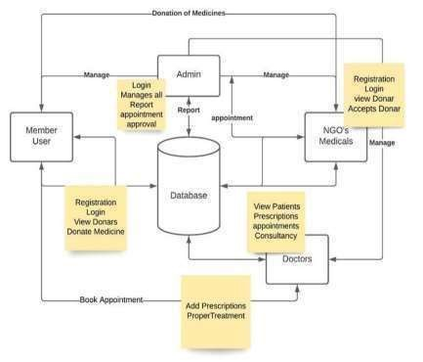
SYSTEM ARCHITECTURE
Description:
The above architecture describes the structure about the online unused medicine donation system for NGOs where it shows the flow about how the donor visits the site and donate medicines to NGOs and NGOs request for the medicine.

Slide 10
Functional Requirements
Users should be able to create an account and authenticate themselves to access the platform's features.
Users should be able to list the medicines they want to donate and specify details such as expiry date, quantity, and location.
The platform should allow NGOs to search for available donations based on specific criteria such as location, medicine type, and expiry date.
Users should be able to communicate with each other to discuss donation details and arrange pick-up or delivery.
The platform should have reporting capabilities to help track the number and types of donations, as well as to identify trends and patterns.

Slide 11
The platform should be mobile-friendly to allow users to access it from anywhere.
The platform should be designed with strong security and privacy features to ensure the safety of user data and protect against any potential threats.
The platform should be integrated with social media channels to promote the platform and increase its reach.

Slide 12
SYSTEM REQUIREMENTS
Minimum Software Requirements
Operating system : Windows 11
Database : MYSQL
Front End : HTML, CSS, JavaScript
Back End : Python

Slide 13
Minimum Hardware Requirements
Processor : intel i3
Speed : 2.10GHz
Hard Disk : 512 GB
RAM : 8 GB

Slide 14
MODULES

Slide 15
Module Description:
There are three modules in this project:
Admin module
NGO module
Donor module

Slide 16
Admin Module:
Admin can add different NGOs, and donors.
In this module
Admin can login using his/her credentials into the system.
Admin can view his/her profile and can add other admins into the system.
Admin can also edit and delete the NGO records.
Admin can add doctor records into the system. He can also view the transactions of medicines.
Admin can view all the pending and approved medicines that can be uploaded on the website.
Admin can add different NGOs, and medicines.

Slide 17
NGO Module:
In this module
NGOs can login using his/her credentials into the system.
NGO can view all the list of medicines and request medicines that are available.
Donor Module:
In this module
Donor can register into the system by specifying details like name, mobile no, login id password, address, city, state, pin code, medicine group, gender, and date of birth.
After logging into the system, donor can donate the unused medicines they have.
Donor should provide details such as name, address, city, state, pin code , mobile number, date, selecting the department.

Slide 18
UML DIAGRAMS

Slide 19
USECASE DIAGRAM
Register
login
view medicine request
approve medicines
Admin
request history
request medicine
Donor
donate medicine
NGO
donation history
medicine available
manage NGOs

Slide 20
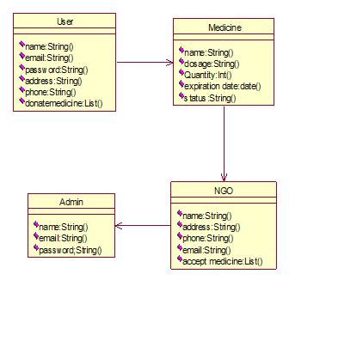
CLASS DIAGRAM

Slide 21
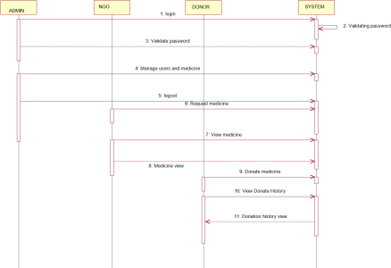
SEQUENCE DIAGRAM

Slide 22
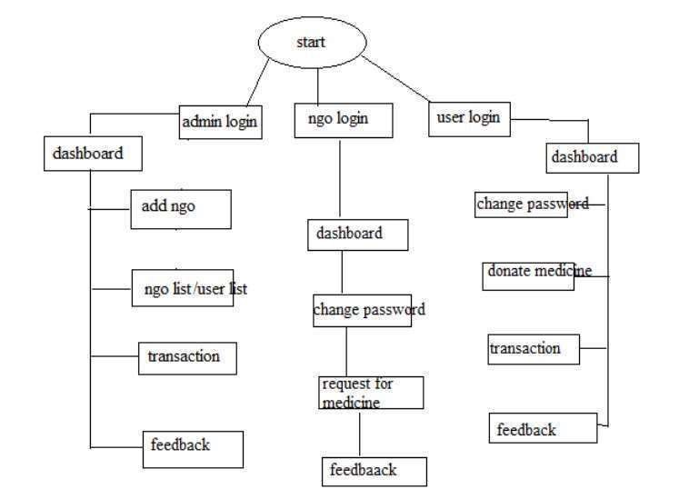
ACTIVITY DIAGRAM

Slide 23
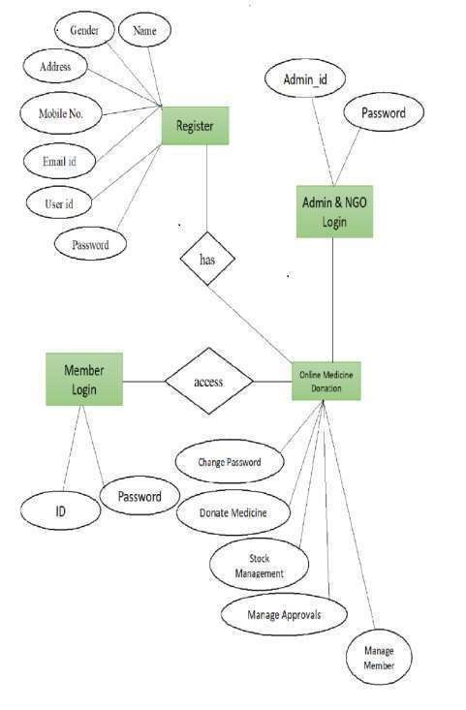
E-R DIAGRAM

Slide 24
SCREEN SHOTS

Slide 25
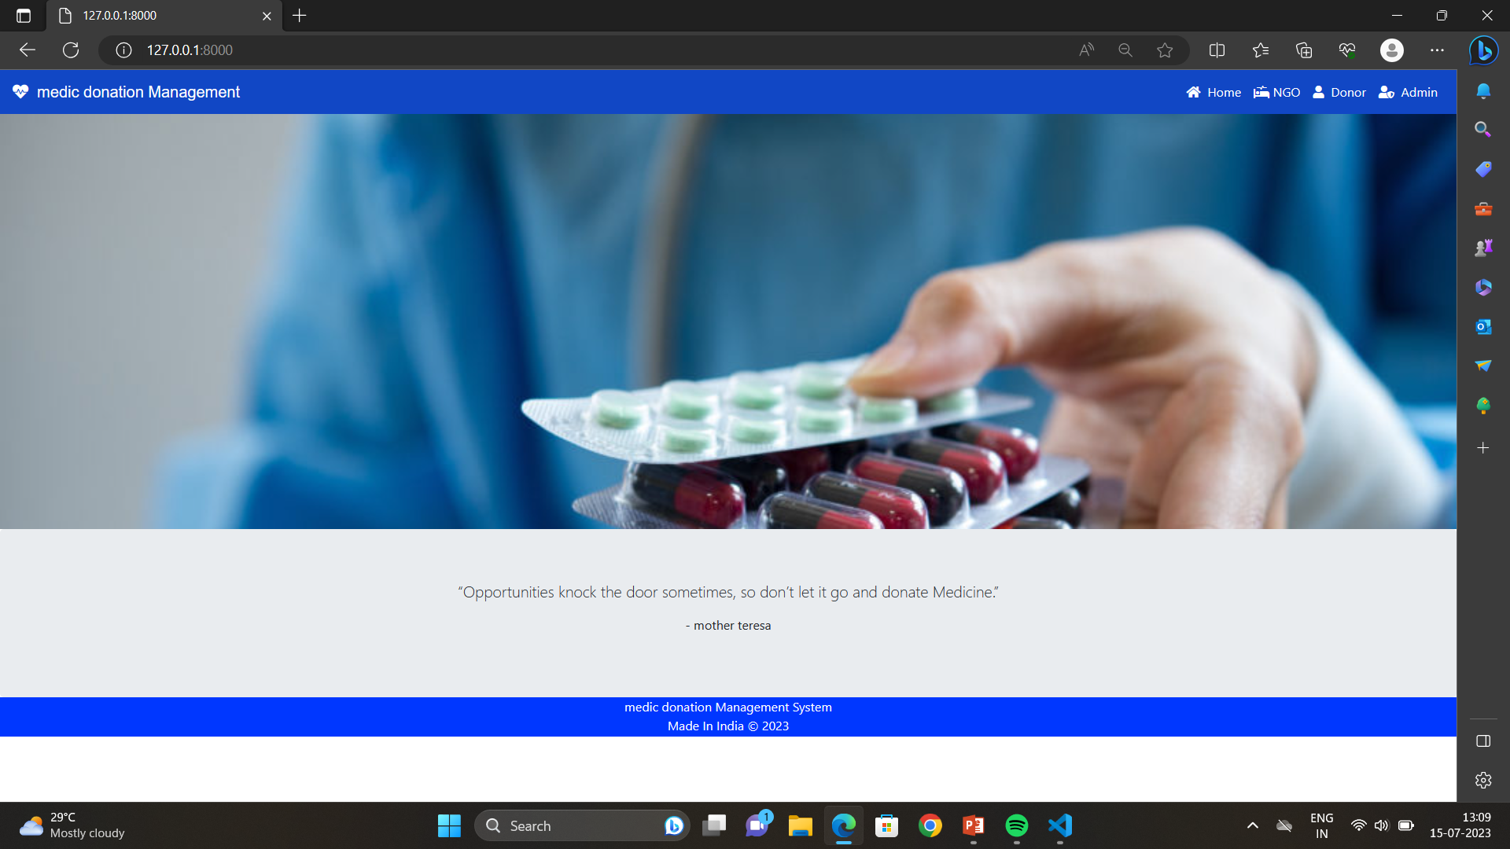
Description : The above screenshot displays Home Page of the project.

Slide 26
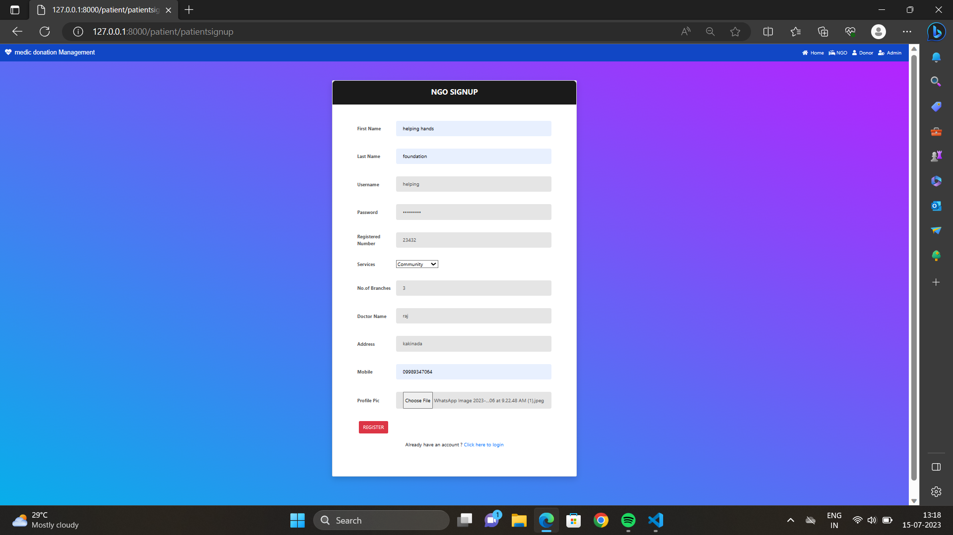
Description: The above screenshot displays the NGO signup page consists of Ngo name, regno, password, address , doctor name, mobile no, profile pic.

Slide 27
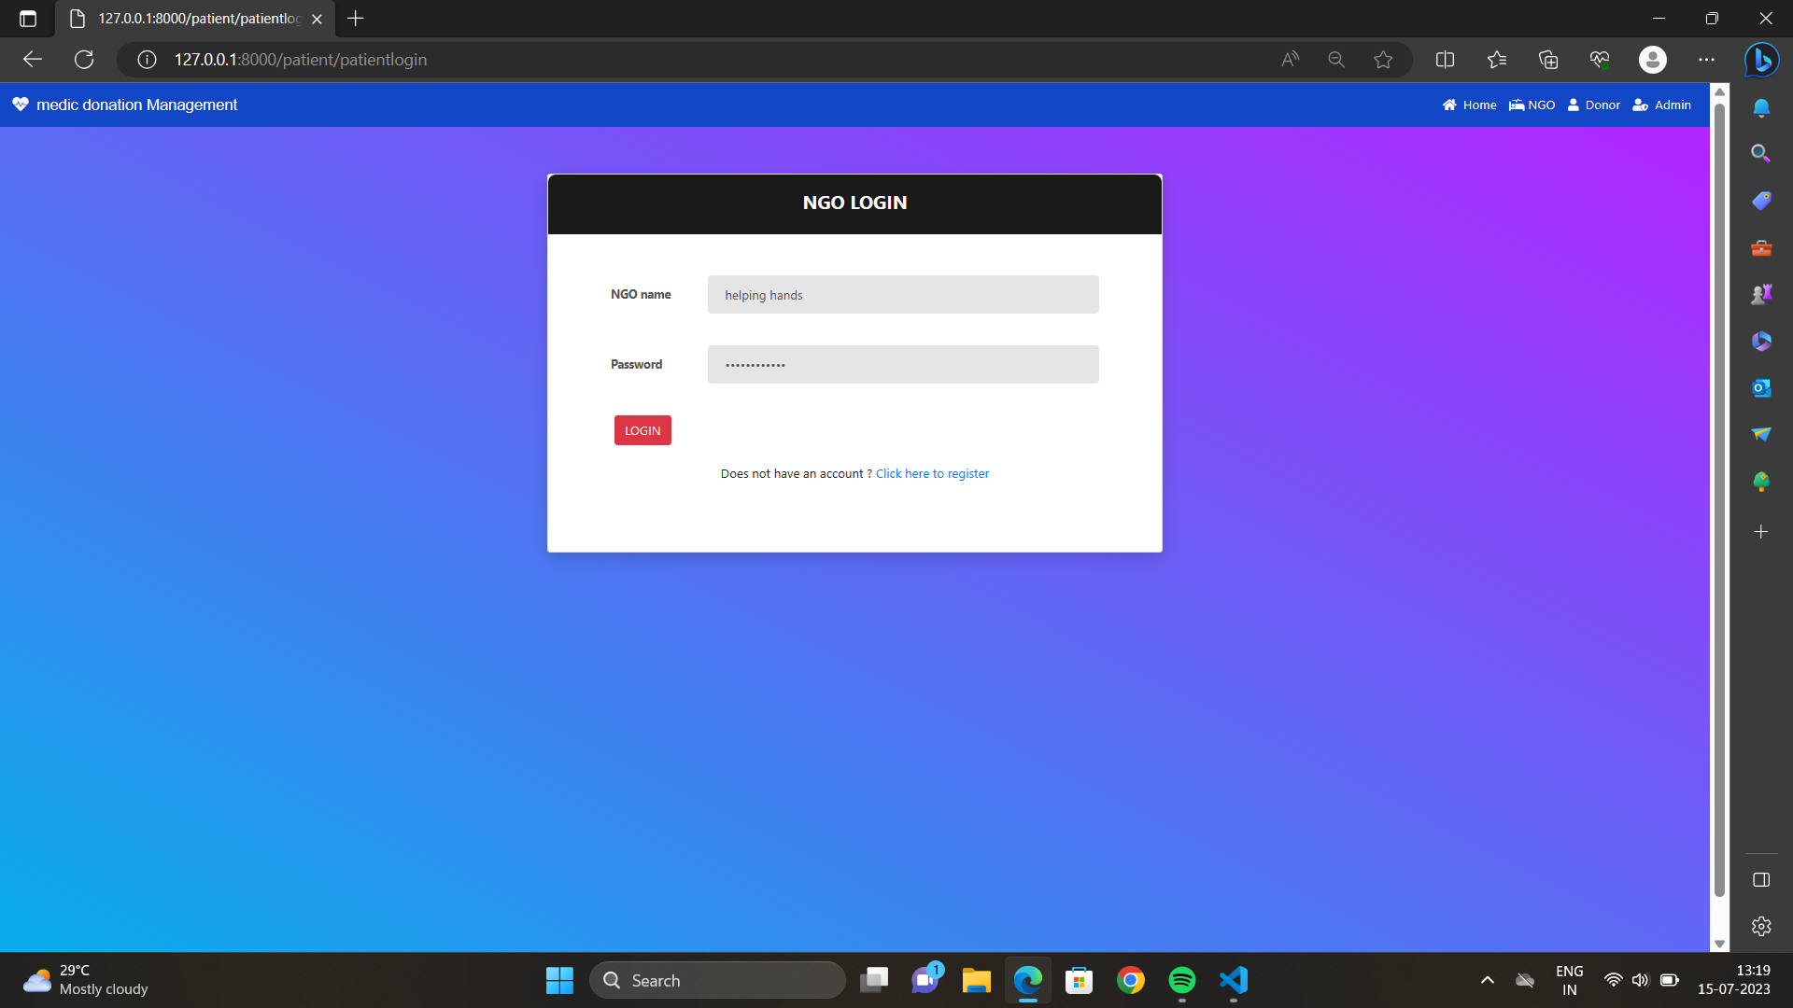
Description: The above screenshot displays NGO login page consists of NGO Name and Password to login into the page

Slide 28
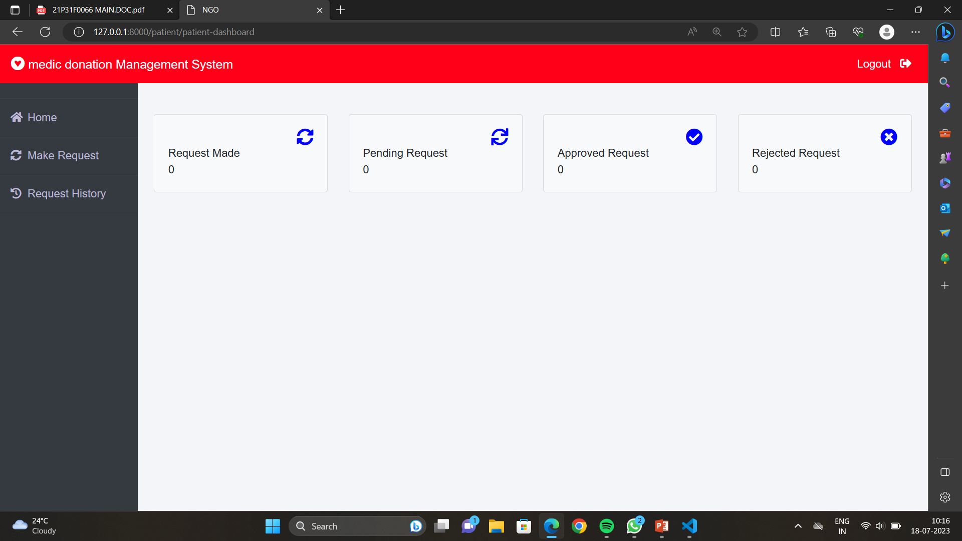
Description: The above screenshot displays the NGOs dashboard page consists of make request, request history, approved request and rejected requests.

Slide 29
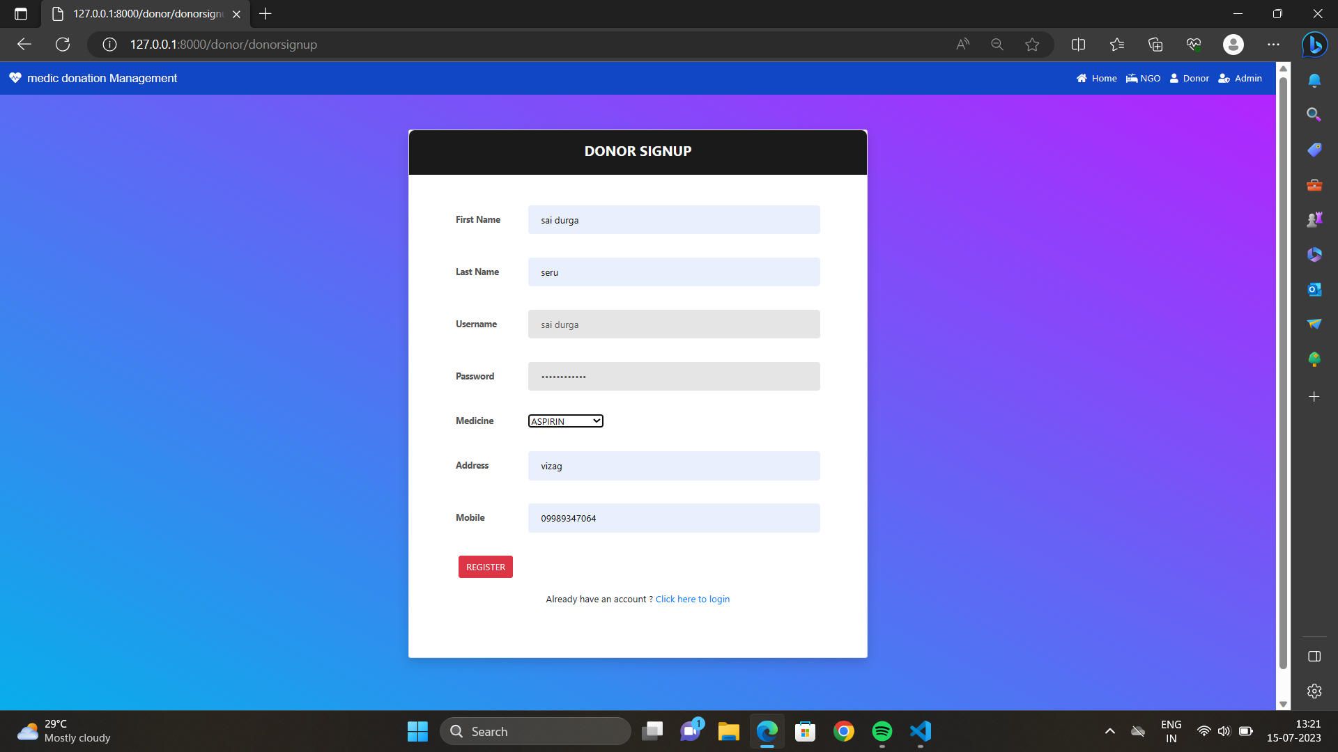
Description: The above screenshot displays donor signup consists of username ,password, address, mobile no, medicine.

Slide 30

Description: The above screenshot displays donor login consists of donor user name and password.

Slide 31

Description: The above screenshot displays donor dashboard consists of donate medicine ,donation history, request history.

Slide 32
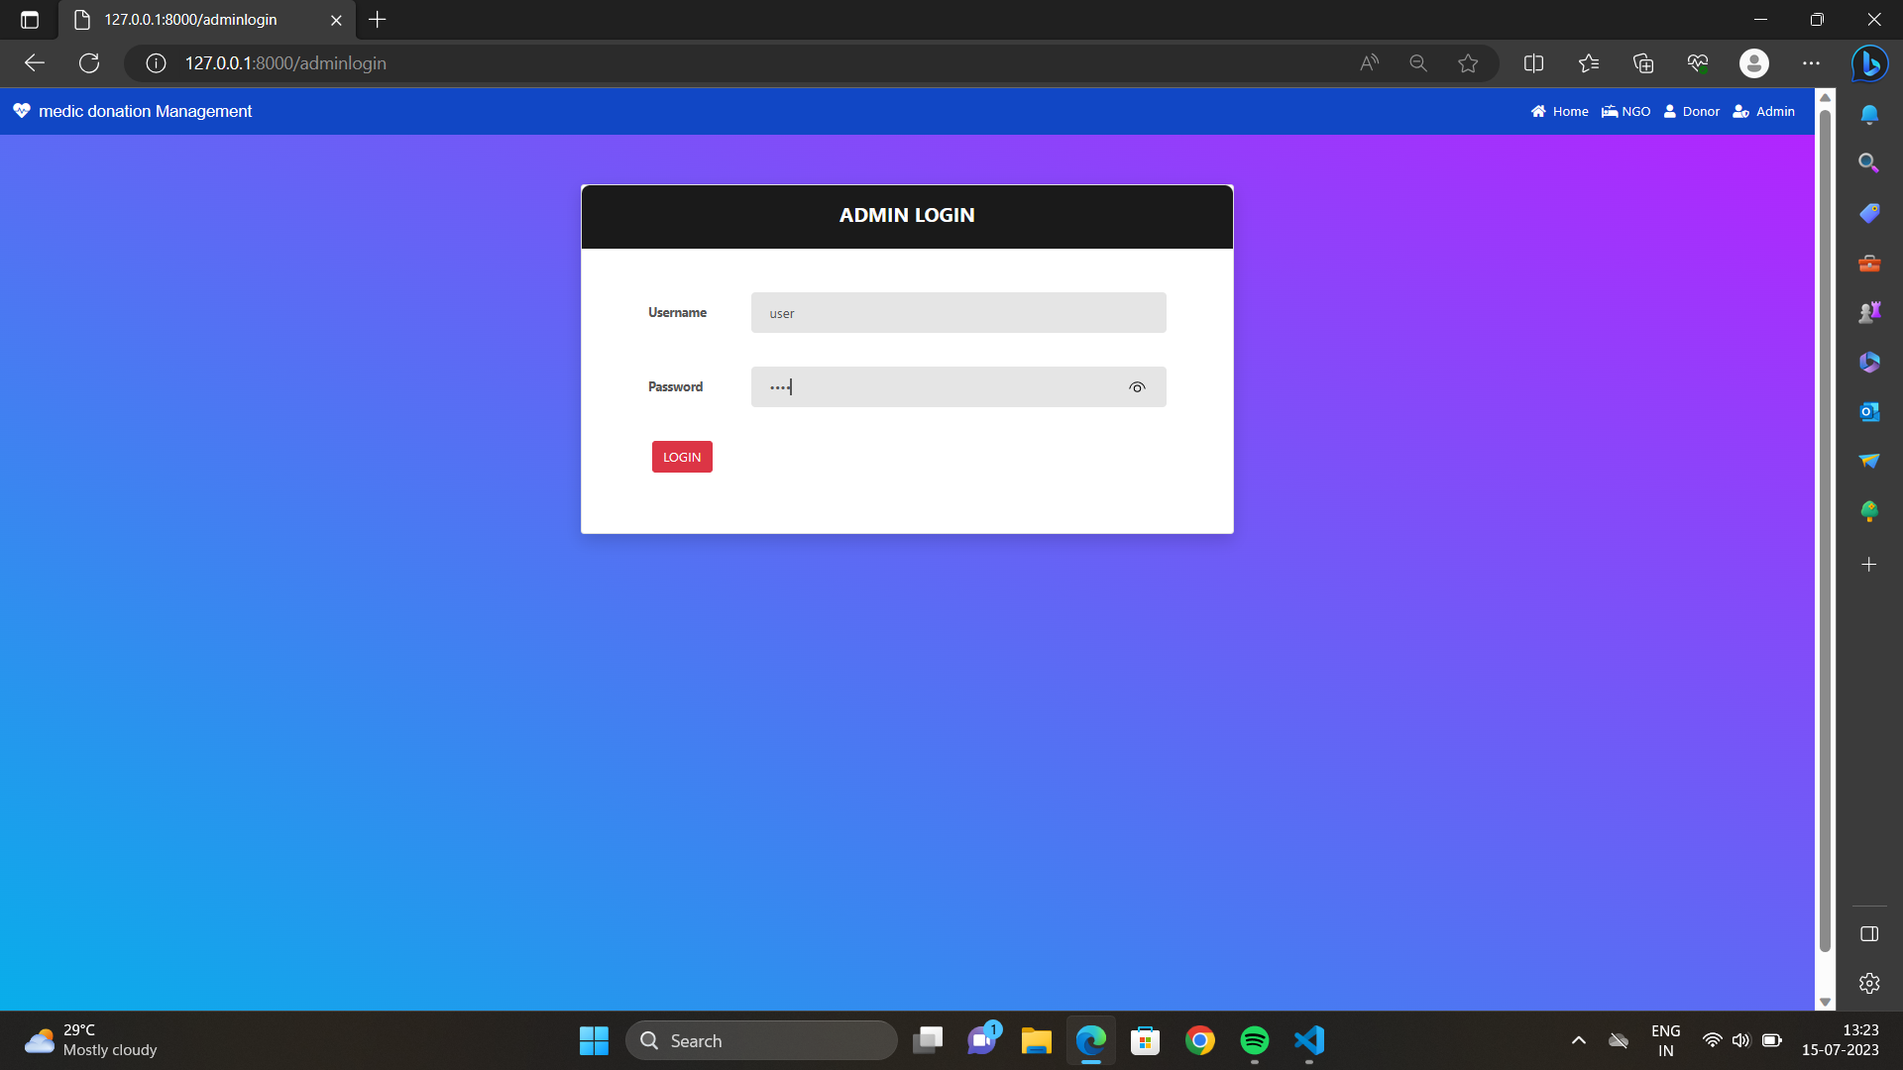
Description: The above screenshot displays the admin login page consists of username And password.

Slide 33
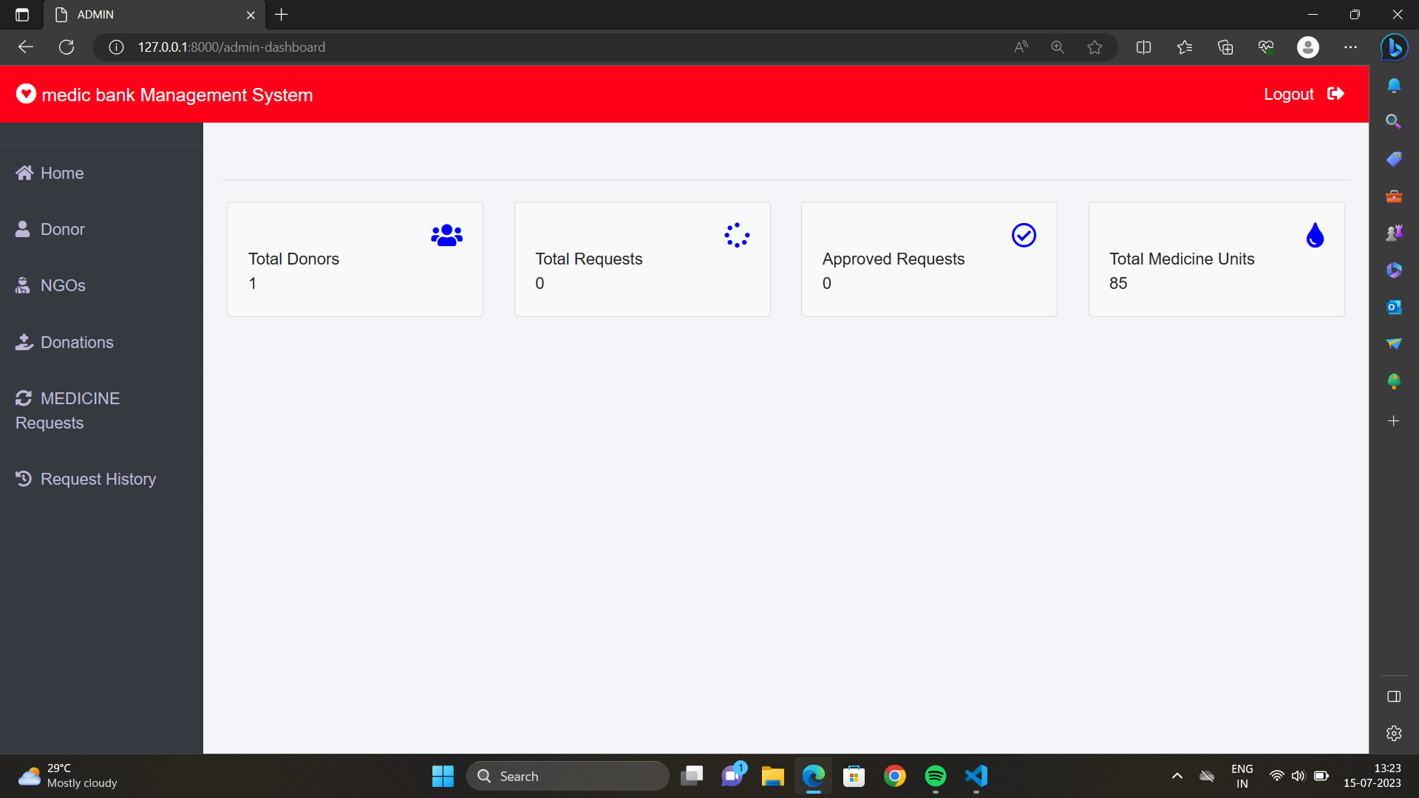
Description: The above screenshot displays admin dashboard consists of Home, Donor, NGO, donations, Medicine request ,request history.

Slide 34
CONCLUSION

Slide 35
Online unused medicine donation system for NGOs is a great way to help people in need. It is a convenient and easy way to donate unused medicines, and it ensures that the medicines are distributed to the people who need them most.
There are many benefits to online unused medicine donations for NGOs. First, it is a convenient way to donate. Users can donate their unused medicines from the comfort of their own homes. Second, it is an easy way to donate.
Users simply need to create an account, select the medicines they want to donate, and enter the quantity. Third, it ensures that the medicines are distributed to the people who need them most. NGOs have a network of people in need, and they are able to distribute the medicines to the people who need them the most.
If you have unused medicines, please consider donating them to an NGO. It is a great way to help people in need and make a difference in the world.

Slide 36
THANK YOU

